Slide 1
Overview

Slide 2
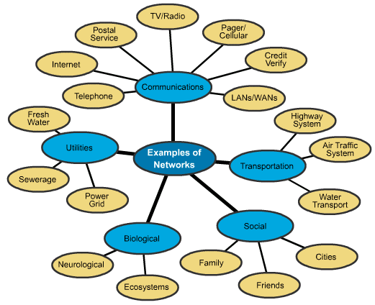
Network Users

Slide 3
Topology
A network can be classified according to the Physical connectivity between the systems (PCs, Laptops, switches, Gateways, etc.) – Called as Topology
Basic Topologies:
-Bus
-Ring
-Star

Slide 4
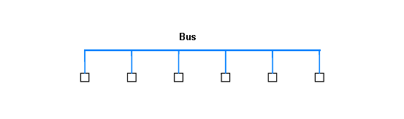
Bus
Series of computers/systems (say, switches or nodes) connected by a link in a line.
All computers except end computers/systems have the same number of links (2 ) connected to them
End computers/systems have ‘1’ link connected

Slide 5
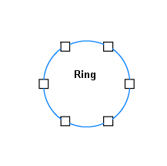
RING
Computers/systems connected in a closed loop
Each Node has ‘2’ connectors

Slide 6
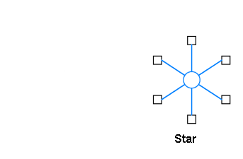
STAR
All Nodes connected to a central point

Slide 7
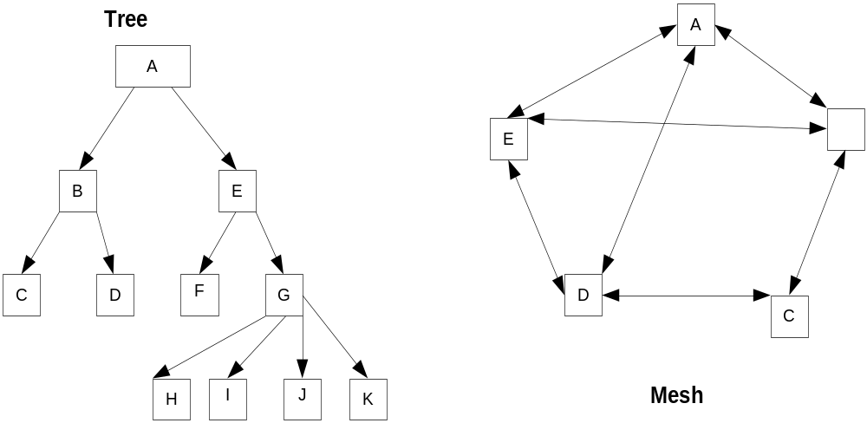
Topology: Derived
Derived Topologies: Tree, Mesh
Notes:
Tree: is mixture of STAR
MESH: is mixture of all types of basic network – RING, STAR, BUS…..

Slide 8
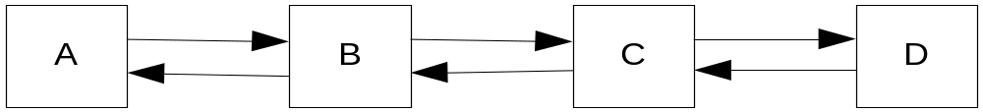
Why So Many Topologies
Each has own advantages & Disadvantages:
BUS
Bus requires fewer cables in comparison to Star
May be disable if cable is cut or any node is out of order
In optical network it is difficult to design power budget
Generally Preferred for LAN

Slide 9
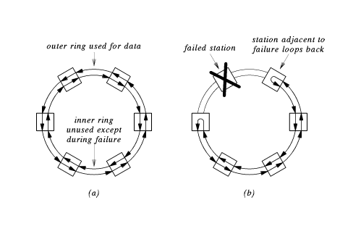
Ring: Adv. & Dis. Adv.
Ring ease Protocols; More Latency; Difficult to design power budget for Optical network; More robust as Reliability is concerned – preferred for MAN

Slide 10
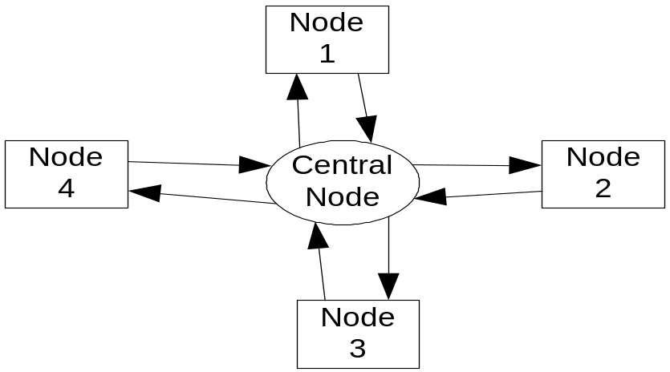
Star: Adv. & Dis. Adv.
Not so reliable, i.e., if hub fails
Requires more cables
Star is easier to design optical power-budget
Easy to implement as flexible – LAN, CATV, Telephone Network (most of the companies prefers STAR topology as LAN/Access Network Configuration)

Slide 11
Tree & Mesh: Adv. & DisAdv.
  Tree: Flexible to design, i.e, can support random connection - Hence preferred by service provider like, CATV, Telephone Network
  Mesh: Geographical location of main cities & countries had been connected in an asymmetric manner, hence in WAN & some of the MANs are Mesh Topo..
  - Routing is Complex

Slide 12
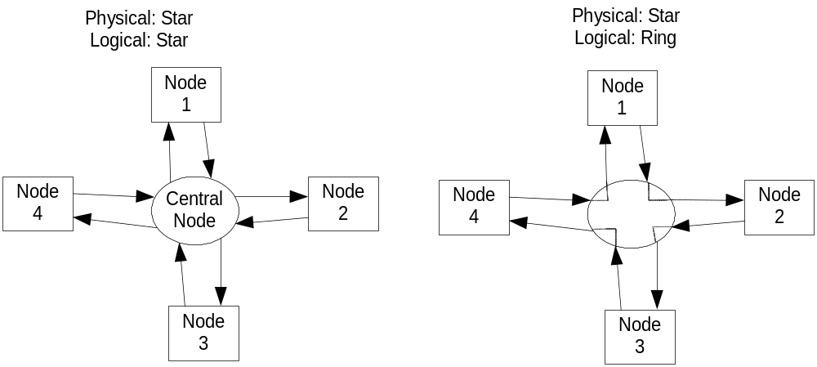
Physical & Logical Topology

Slide 13
Unicast, Broadcast, Multicast
Unicast: A node transmitting to another single node in a network(telecom one-to-one)
Broadcast: A node transmitting to all the nodes of a network (some emergency news!)
Multicast: A node transmitting some selective nodes of a network (neither single nor all nodes; Imp. In point of view of VPN- Company teleconferencing)

Slide 14
Message, Frame & Packet
Message: Complete File considered as one message. It has no minimum or maximum size limitation -- from a few bytes to some hundreds of megabytes. Example: a file of text, program!
Frame: A Block of data suitable for transmission as single unit. The frame Minimum & Maximum size depends on protocol! Example: Ethernet.
Packet: Block of data sent over network. It is generally smaller in size in comparison to message. Example: ATM, IP Packets.

Slide 15
Bit Rate, Baud Rate, Bandwidth
Data transmission rates: expressed in bit & baud rate
Bit rate: Number of bits transmitted per unit time (here we consider unit time as one second) – Transmission rate.
Baud rate: measure of the number of symbols (Characters) transmitted per unit time;
  Each symbol may normally consists of a no. of bits – hence, only baud rate = bit rate → when there is one bit per symbol
Bandwidth: Frequencies carried by a signal/system/medium. (Fiber: f = c/λ).

Slide 16
Arrival rate, Departure rate and Propagation
Arrival rate: Number of bits arrived at a node per second
Departure rate: Number of bits served at a node per second – Same as Service Rate & Transmission rate & Capacity.
Propagation delay: Time taken to travel from one node to other through a medium (like, fiber, copper, space, etc)

Slide 17
How Networks Evolved
A Network: system for connecting computer using a single transmission technology
Computer Networking: Study to know Principles of Operation of a Network & Inter Connecting different different Networks
First Generation: copper based → bandwidth <= a few 10’s of Mbps; Example: Ethernet, token bus, token ring, ARPANET, SNA (IBM), DNA(DEC)

Slide 18
How Computer Network Evolved (Contd.)
Second Generation: fiber as copper-replacement in traditional architectures →bandwidth ~ 100Mbps to a few Gbps; Example: FDDI, DQDB, SDH/SONET
Third Generation: Fiber with WDM → bandwidth Tbps; Example: Lambdanet, MONET etc.

Slide 19
Network Classification
According to Size – LAN/Access, MAN, WAN
Types Services – Voice (Telecom) or Data (Data Network- Internet)!
According to Physical Medium – Wireless, Wired Network
Future Trend seems to be all as ONE network, i.e., Data-Network. As there will be no discrimination between bits of voice, video & computational data.

Slide 20
What’s the Internet?
What is Protocol?
Network edge
Network core
Multiplexing: TDM, FDM & WDM
Circuit, Packet, Message Switching
Access net, physical media
Performance: loss, delay
ISO-OSI & Internet Layer service models
Backbones, NAPs, ISPs

Slide 21





What’s the Internet: “nuts and bolts” view
millions of connected computing devices: hosts, end-systems
  pc’s workstations, servers
  PDA’s phones, toasters
  running network apps
communication links
  fiber, copper, radio, satellite
routers: forward packets (chunks) of data thru network
router
workstation
server
mobile
local ISP
regional ISP
company
network

Slide 22
What’s the Internet: “nuts and bolts” view
protocols: control sending, receiving of msgs
  e.g., TCP, IP, HTTP, FTP, PPP
Internet: “network of networks”
  loosely hierarchical
  public Internet versus private intranet
Internet standards
  RFC: Request for comments
  IETF: Internet Engineering Task Force
router
workstation
server
mobile
local ISP
regional ISP
company
network

Slide 23
What’s the Internet: a service view
communication infrastructure enables distributed applications:
  WWW, email, games, e-commerce, database., voting, file sharing
communication services provided:
  connectionless
  connection-oriented
cyberspace:
  “a consensual hallucination experienced daily by billions of operators, in every nation, ...."

Slide 24
What’s a Network protocol?
all communication activity in Internet governed by protocols
A Protocol is a set of rules that make communication on a network more efficient
protocols define:
- format,
- order of message sent and received among network entities,
- actions taken on message transmission, receipt

Slide 25


What’s a protocol?
a human protocol and a computer network protocol:
Hi
TCP connection
req.
Hi
TCP connection
reply.
Got the
time?
Get http://gaia.cs.umass.edu/index.htm
2:00
<file>
time

Slide 26
A closer look at network structure:
network edge: applications and hosts
network core:
  routers
  network of networks
access networks, physical media: communication links

Slide 27
The network edge:
end systems (hosts):
  run application programs
  e.g., WWW, email
  at “edge of network”
client/server model
  client host requests, receives service from server
  e.g., WWW client (browser)/ server; email client/server
peer-peer model:
  host interaction symmetric

Slide 28
Network edge: connection-oriented service
Goal: data transfer between end sys.
handshaking: setup (prepare for) data transfer ahead of time
  Hello, hello back human protocol
  set up “state” in two communicating hosts
TCP - Transmission Control Protocol
  Internet’s connection-oriented service
TCP service
reliable, in-order byte-stream data transfer
  loss: acknowledgements and retransmissions
flow control:
  sender won’t overwhelm receiver
congestion control:
  senders “slow down sending rate” when network congested

Slide 29
Network edge: connectionless service
App’s using TCP:
HTTP (WWW), FTP (file transfer), Telnet (remote login), SMTP (email)
App’s using UDP:
streaming media, teleconferencing, Internet telephony
Goal: data transfer between end systems
  same as before!
UDP - User Datagram Protocol: Internet’s connectionless service
  unreliable data transfer
  no flow control
  no congestion control

Slide 30
The Network Core
mesh of interconnected routers
the fundamental question: how is data transferred through net?
  circuit switching: dedicated circuit per call: telephone net
  packet-switching: data sent thru net in discrete “chunks”

Slide 31
Network Core: Circuit Switching
End-end resources reserved for “call”
link bandwidth, switch capacity
dedicated resources: no sharing
circuit-like (guaranteed) performance
call setup required

Slide 32
Network Core: Circuit Switching
network resources (e.g., bandwidth) divided into “pieces”
pieces allocated to calls
resource piece idle if not used by owning call (no sharing)
dividing link bandwidth into “pieces”
  frequency division
  time division

Slide 33
Circuit Switching: FDMA =WDMA and TDMA
Example:
FDMA
4 users
frequency
time
TDMA
frequency
time
Notes:
Two simple multiple access control techniques.
Each mobile’s share of the bandwidth is divided into portions for the uplink and the downlink. Also, possibly, out of band signaling.
As we will see, used in AMPS, GSM, IS-54/136

Slide 34
Network Core: Packet Switching
each end-end data stream divided into packets
user A, B packets share network resources
each packet uses full link bandwidth
resources used as needed,
resource contention:
aggregate resource demand can exceed amount available
congestion: packets queue, wait for link use
store and forward: packets move one hop at a time
  transmit over link
  wait turn at next link

Slide 35
Network Core: Packet Switching
10 Mbs
Ethernet
A
C
statistical multiplexing
1.5 Mbs
B
queue of packets
waiting for output
link
45 Mbs
D
E
Packet-switching versus circuit switching

Slide 36
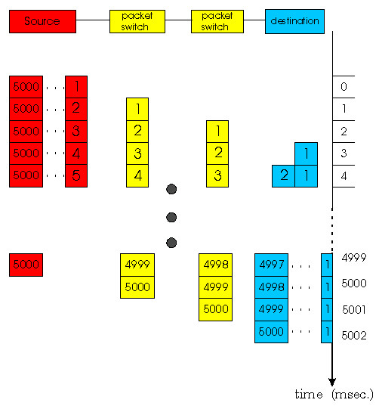
Network Core: Packet Switching
Packet-switching: store and forward behavior
break message into smaller chunks: packets”
Store-and-forward: switch waits until chunk has completely arrived, then forwards/routes
Q: what if message was sent as single unit?

Slide 37
Packet switching versus circuit switching
Packet switching allows more users to use network!
1 Mbit link
each user:
  100Kbps when “active”
  active 10% of time
circuit-switching:
  10 users
N users
1 Mbps link
. packet switching:
  -with 35 users, probability > 10 active less than .0004

Slide 38
Packet switching versus circuit switching
Great for bursty data: Packet Switching
  resource sharing
  no call setup
Excessive congestion: packet delay and loss
  protocols needed for reliable data transfer, congestion control
Q: How to provide circuit-like behavior?
  bandwidth guarantees needed for audio/video apps: One of the Present Challenges!

Slide 39
Packet Switching Vs Message Switching
Adv. of Pak. Sw. respect of Msg. Sw.
- Less end-to-end delay in case of multihop network
- As packet size small, probability of PER is less, hence avoids congestion due to retransmission. (as, PER ≅ BER x Pak. Length)
Disadv. of Pak. Sw. respect of Msg. Sw.
-Amount of header overhead per byte of data is more.

Slide 40
Packet-switched networks: routing
Goal: move packets among routers from source to destination
  we’ll study several path selection algorithms
datagram network:
  destination address determines next hop
  routes may change during session
  analogy: driving, asking directions
virtual circuit network:
  each packet carries tag (virtual circuit ID), tag determines next hop
  fixed path determined at call setup time, remains fixed thru call
  routers maintain per-call state

Slide 41
Access networks and physical media
Q: How to connect end systems to edge router?
residential access nets
institutional access networks (school, company)
mobile access networks
Keep in mind:
bandwidth (bits per second) of access network?
shared or dedicated?

Slide 42
Residential access: point to point access
Dialup via modem
  up to 56Kbps direct access to router (conceptually)
ISDN: integrated services digital network: 128Kbps all-digital connect to router
ADSL: asymmetric digital subscriber line
  up to 1 Mbps home-to-router
  up to 8 Mbps router-to-home
  ADSL deployment: happening

Slide 43
Residential access: cable modems
HFC: hybrid fiber coax
  asymmetric: up to 10Mbps upstream, 1 Mbps downstream
network of cable and fiber attaches homes to ISP router
  shared access to router among home
  issues: congestion, dimensioning
deployment: available via cable companies, e.g., MediaOne

Slide 44
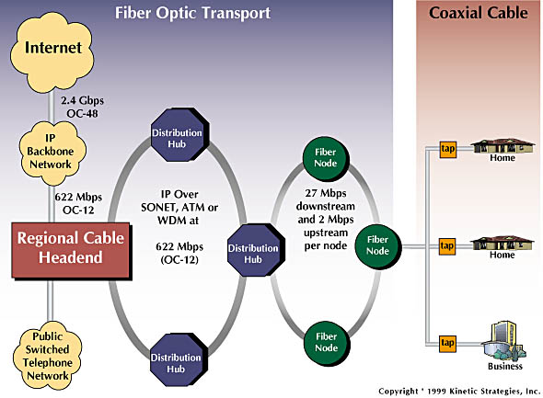
Residential access: cable modems

Slide 45
Institutional access: local area networks
company/univ local area network (LAN) connects end system to edge router
Ethernet:
  shared or dedicated cable connects end system and router
  10 Mbs, 100Mbps, Gigabit Ethernet
deployment: institutions, home LANs happening now
LANs:

Slide 46
Wireless access networks
shared wireless access network connects end system to router
wireless LANs:
  radio spectrum replaces wire
  e.g., Lucent Wavelan 11 Mbps
wider-area wireless access
  CDPD: wireless access to ISP router via cellular network
router
base
station
mobile
hosts

Slide 47
Home Networks
Typical home network components:
ADSL or cable modem
router/firewall
Ethernet
wireless access
point
wireless
laptops
to/from
cable
headend
cable
modem
router/
firewall
wireless
access
point
Ethernet
(switched)

Slide 48
Physical Media
Twisted Pair (TP)
two insulated copper wires
  Category 3: traditional phone wires, 10 Mbps Ethernet
  Category 5 TP: 100Mbps Ethernet
physical link: transmitted data bit propagates across link
guided media:
  signals propagate in solid media: copper, fiber
unguided media:
  signals propagate freely, e.g., radio

Slide 49


Physical Media: coax, fiber
Coaxial cable:
wire (signal carrier) within a wire (shield)
  baseband: single channel on cable
  broadband: multiple channel on cable
bidirectional
common use in 10Mbs Ethernet
Fiber optic cable:
glass fiber carrying light pulses
high-speed operation:
  100Mbps Ethernet
  high-speed point-to-point transmission (e.g., 5 Gps)
low error rate

Slide 50
Physical media: radio
signal carried in electromagnetic spectrum
no physical “wire”
bidirectional
propagation environment effects:
  reflection
  obstruction by objects
  interference
Radio link types:
microwave
  e.g. up to 45 Mbps channels
LAN (e.g., WaveLAN)
  2Mbps, 11Mbps
wide-area (e.g., cellular)
  e.g. CDPD, 10’s Kbps
satellite
  up to 50Mbps channel (or multiple smaller channels)
  270 Msec end-end delay
  geosynchronous versus LEOS

Slide 51
Delay in packet-switched networks
packets experience delay on end-to-end path
four sources of delay at each hop
nodal processing:
  check bit errors
  determine output link
queueing
  time waiting at output link for transmission
  depends on congestion level of router
transmission
A
propagation
B
nodal
processing
queueing

Slide 52
Delay in packet-switched networks
Transmission delay:
R=link bandwidth (bps)
L=packet length (bits)
time to send bits into link = L/R
Propagation delay:
d = length of physical link
s = propagation speed in medium (~2x10⁸ m/sec)
propagation delay = d/s
Note: s and R are very different quantities!
transmission
A
propagation
B
nodal
processing
queueing

Slide 53

Queueing delay (revisited)
R=link bandwidth (bps)
L=packet length (bits)
a=average packet arrival rate
traffic intensity = La/R
La/R ~ 0: average queueing delay small
La/R -> 1: delays become large
La/R > 1: more “work” arriving than can be serviced, average delay infinite!

Slide 54
Why Network Software
Sending data through raw hardware is awkward and inconvenient - doesn't match programming paradigms well
May not be able to send data to every destination of interest without other assistance
Network software provides high-level interface to applications

Slide 55
What & Why Protocol?
Name is derived from the Greek protokollen, the index to a scroll
Diplomats use rules, called protocols, as guides to formal interactions
A network protocol or computer communication protocol is a set of rules that specify the format and meaning of messages exchanged between computers across a network
  Format is sometimes called syntax
  Meaning is sometimes called semantics
Protocols are implemented by protocol software

Slide 56
Protocol “Layers”
Networks are complex!
many “pieces”:
  hosts
  routers
  links of various media
  applications
  Rules for communicatins
  hardware, software
Question:
Is there any hope of organizing structure of network?
Or at least our discussion of networks?

Slide 57
How Many Protocols?
Computer communication across a network is a very hard problem
Complexity requires multiple protocols, each of which manages a part of the problem
May be simple or complex; must all work together

Slide 58
Protocol Suites
A set of related protocols that are designed for compatibility is called a protocol suite
Protocol suite designers:
  Analyze communication problem
  Divide problems into sub-problems
  Design a protocol for each sub-problem
A well-designed protocol suite
  Is efficient and effective - solves the problem without redundancy and makes best use of network capacity
  Allows replacement of individual protocols without changes to other protocols

Slide 59
Organization of air travel
ticket (purchase)
baggage (check)
gates (load)
runway takeoff
airplane routing
ticket (complain)
baggage (claim)
gates (unload)
runway landing
airplane routing
airplane routing
a series of steps

Slide 60
Organization of air travel: a different view
ticket (purchase)
baggage (check)
gates (load)
runway takeoff
airplane routing
ticket (complain)
baggage (claim)
gates (unload)
runway landing
airplane routing
airplane routing
Layers: each layer implements a service
  via its own internal-layer actions
  relying on services provided by layer below

Slide 61
Distributed implementation of layer functionality
ticket (purchase)
baggage (check)
gates (load)
runway takeoff
airplane routing
ticket (complain)
baggage (claim)
gates (unload)
runway landing
airplane routing
Departing airport
arriving airport
intermediate air traffic sites
airplane routing
airplane routing
airplane routing

Slide 62
Why layering?
Dealing with complex systems:
Layering model is a solution to the problem of complexity in network protocols
Model suggests dividing the network protocol into layers, each of which solves part of the network communication problem
These layers have several constraints, which ease the design problem
Network protocol designed to have a protocol or protocols for each layer

Slide 63
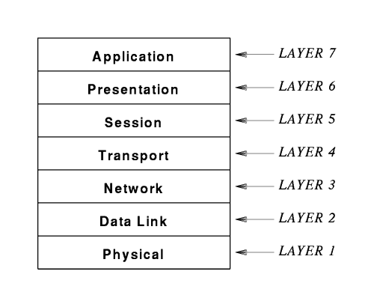
ISO’s 7-Layer Model (OSI)

Slide 64
Functions of Layers in OSI
Many modern protocols do not exactly fit the ISO model, and the ISO protocol architecture is mostly of historic interest
Concepts are still largely useful and terminology persists
Layer 7: Application
  Application-specific protocols such as FTP and SMTP (electronic mail)
Layer 6: Presentation
  Common formats for representation of data
Layer 5: Session
  Management of sessions such as login to a remote computer
Layer 4: Transport
  Reliable or Unreliable delivery of data between computers
Layer 3: Network
  Address assignment, routing, forwarding and data delivery across a network
Layer 2: Data Link
  Format of data in frames and delivery of frames through network interface
Layer 1: Physical
  Basic network hardware – to transmit bits

Slide 65
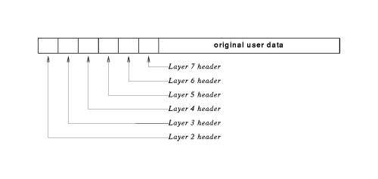
Protocol Header
The software at each layer communicates with the corresponding layer through information stored in headers
Each layer adds its header to the front of the message from the next higher layer
Headers are nested at the front of the message as the message traverses the network

Slide 66
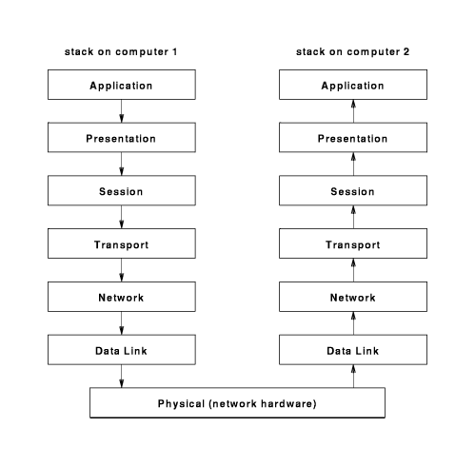
ISO-OSI Layered Architecture

Slide 67
Internet protocol stack
application: supporting network applications (OSI’s --Application+Presentation+ Session)
  ftp, smtp, http
transport: host-host data transfer
  tcp, udp
network: routing of datagrams from source to destination
  ip, routing protocols
link: data transfer between neighboring network elements
  ppp, ethernet
physical: bits “on the wire”
application
transport
network
link
physical

Slide 68
Layering: logical communication
Each layer:
distributed
“entities” implement layer functions at each node
entities perform actions, exchange messages with peers
application
transport
network
link
physical
network
link
physical
application
transport
network
link
physical
application
transport
network
link
physical
application
transport
network
link
physical

Slide 69
Layering: logical communication
E.g.: transport
take data from app
add addressing, reliability check info to form “datagram”
send datagram to peer
wait for peer to ack receipt
analogy: post office
data
application
transport
network
link
physical
transport
ack
network
link
physical
application
transport
network
link
physical
data
data
application
transport
network
link
physical
application
transport
network
link
physical
transport

Slide 70
Layering: physical communication
data
application
transport
network
link
physical
network
link
physical
application
transport
network
link
physical
data
application
transport
network
link
physical
application
transport
network
link
physical

Slide 71
Protocol layering and data
Each layer takes data from above
adds header information to create new data unit
passes new data unit to layer below
source
destination
M
application
transport
network
link
physical
application
transport
network
link
physical
M
message
H
M
H
t
M
segment
t
H
H
H
H
M
datagram
n
t
M
n
t
H
H
H
H
H
H
M
frame
l
n
t
M
l
n
t

Slide 72

Encapsulating Data
Application
Presentation
Upper Layer Data
Session
Segment
Transport
TCP Header
Upper Layer Data
Network
Packet
IP Header
Data
LLC Header
Data
FCS
Data Link
Frame
MAC Header
Data
FCS
Physical
Bits
0101110101001000010

Slide 73
De-encapsulating Data
Application
Presentation
Session
Upper Layer Data
Transport
Upper Layer Data
TCP Header
Network
TCP+ Upper Layer Data
IP Header
IP + TCP + Upper Layer Data
Data Link
LLC Header
LLC Hdr + IP + TCP + Upper Layer Data
MAC Header
Physical
0101110101001000010

Slide 74
Internet structure: network of networks
roughly hierarchical
national/international backbone providers (NBPs)
  e.g. BBN/GTE, Sprint, AT&T, IBM, UUNet
  interconnect (peer) with each other privately, or at public Network Access Point (NAPs)
regional ISPs
  connect into NBPs
local ISP, company
  connect into regional ISPs
local
ISP
regional ISP
NBP B
NAP
NAP
NBP A
regional ISP
local
ISP

Slide 75
Summary
Covered a lot
Internet overview
what’s a protocol?
network edge, core, access network
  packet-switching versus circuit-switching
performance: loss, delay
layering and service models
backbones, NAPs, ISPs
history

